Slide 1
BT4222 Presentation Group 15
Word2Vec Analysis and Comment Generation using r/Singapore Data
(Singaporean English)
15 November 2019
Daniel Lee
James Chua

Slide 2

Group 15 James, Daniel
Obtaining Data Set
Utilising the pushshift API
Pushshift API allows 1000 reddit comments from a subreddit to be retrieved between a time period

Slide 3
Group 15 James, Daniel
Data Sets Used
From multiple online sources
Reddit Singapore comments from 2012 - 2016
1.2 Million Comments
Reddit Singapore comments from 2019
800k Comments
Combined Reddit Singapore Comments from 2012-2019
3.5 Million Comments
Compare between different time periods
Notes:
Many comments sufficient for word2vec training

Slide 4
Group 15 James, Daniel
Data Preprocessing
Normalising the dictionary
Utilising Regular Expressions
Normalise contractions to their longer forms using
“I’m” to “I am”, “can’t” to “cannot”
Only keep letters in that are english alphabets
Normalise common Singaporean terminology to a common form
“FT” to “Foreign Talent”, “gahmen” to “government”
Removal of stop words and low frequency words to remove noise
Lemmatize words based on their Part of Speech Tag
Forming Bigrams along with Unigrams

Slide 5

Group 15 James, Daniel
Word2Vec Training
Training the model on the data set
To understand the semantic relations of words used on Reddit Singapore based on the context they are used in
Utilised Gensim’s Word2Vec with a Continuous Bag of Words model
Trained a separate model for each data set

Slide 6
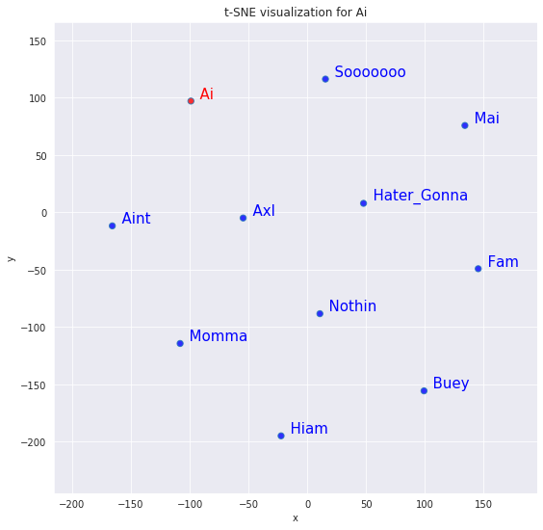
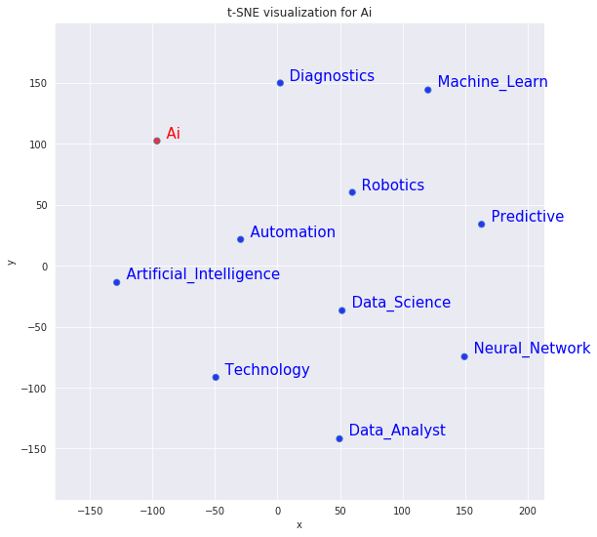
Analysis Historical Semantics of Singaporean English
How usage of words have changed over time
2012 - 2016
2019
Usage of the word AI has changed from being a Singlish term used together with words such as “Ai Mai” to being solely related to Tech and Data Science
Notes:
Usage of the word AI has changed from being in a Singlish term used together with words such as Ai Mai to being related to tech and data science
Using t-SNE to visualise the most similar words

Slide 7
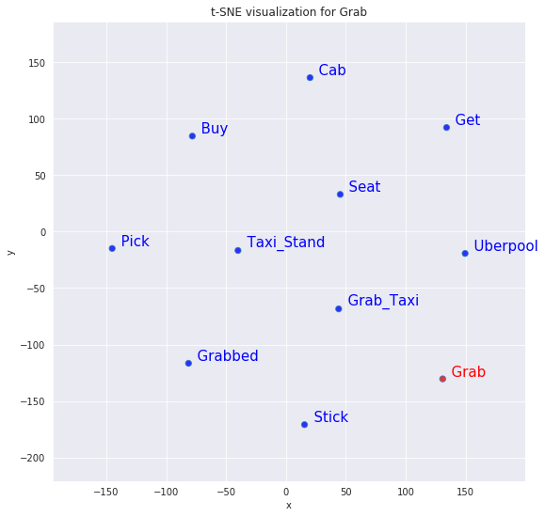
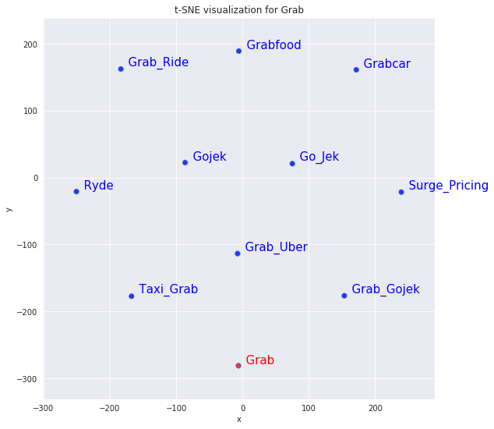
Analysis Historical Semantics of Singaporean English
How usage of words have changed over time
2012 - 2016
2019
Grab used to mostly mean the action of picking/getting something
Now its meaning is closely related to taxis or even food delivery
Notes:
Grab used to mean the action of grabbing/picking smth
Now its meaning is much closely relating to anything related to taxis or even food delivery

Slide 8
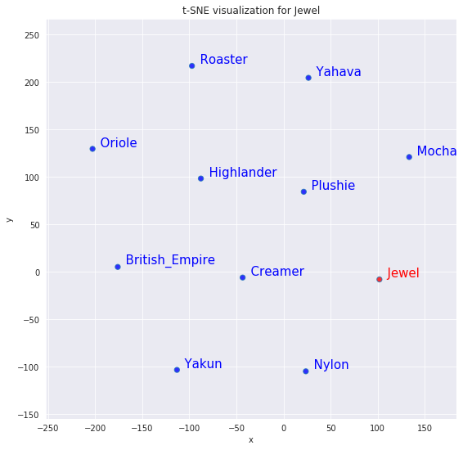
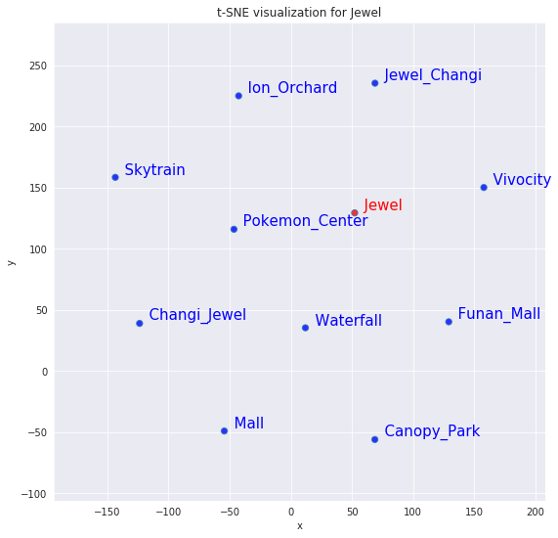
Analysis Historical Semantics of Singaporean English
How usage of words have changed over time
2012 - 2016
2019
Jewel has a much different meaning in 2019 now referring mostly to the Jewel Changi Shopping Mall where it used to refer to Jewel Coffee
Notes:
Jewel has a much different meaning in 2019 now referring mostly to the Jewel Changi Shopping Mall

Slide 9
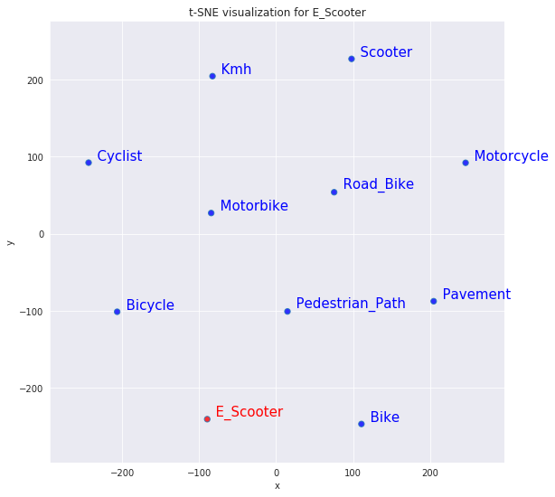
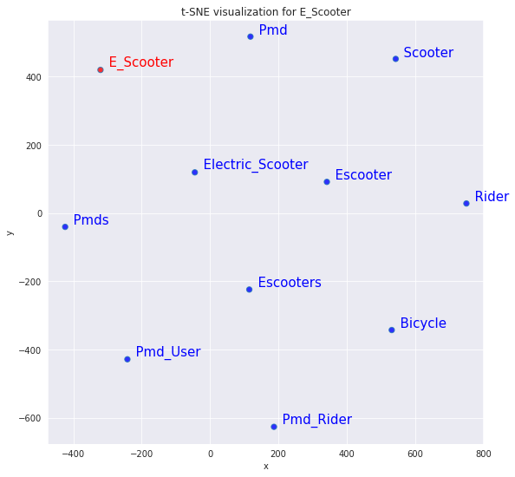
Words that have been Added into Singapore’s Vocabulary
Common usage of new words in recent history
2012 - 2016
2019
PMD has been used widely in 2019 as compared to rarely being used as a term in 2012-2016 as you can see from words that are highly similar to e scooter
Notes:
PMD has been used widely in 2019 as compared to rarely being used as a term in 2012-2016 as you can see from words that are highly similar to escooter

Slide 10
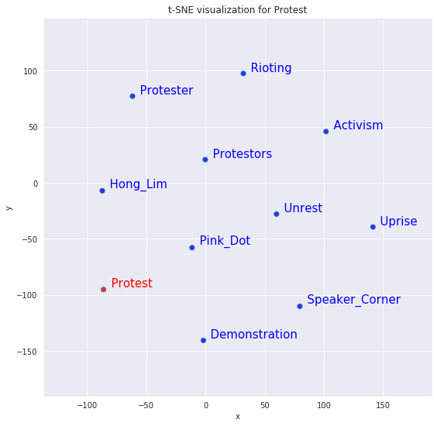
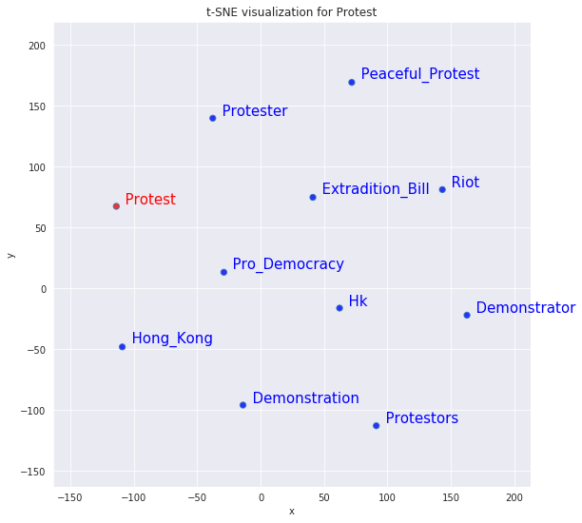
How Singaporean’s felt on certain issues
By looking at the highly related words
2012 - 2016
2019
Discussions about protests used to be about issues at home, such as protests at Hong Lim Park against the 377A Law
Now in 2019 all they are discussing are HK protests
Notes:
Singaporeans feel strongly about protests
From 2012-2016 used to be about issues at home, such as protests at honglim park against 377a
Now in 2019 all they are discussing are HK protests

Slide 11
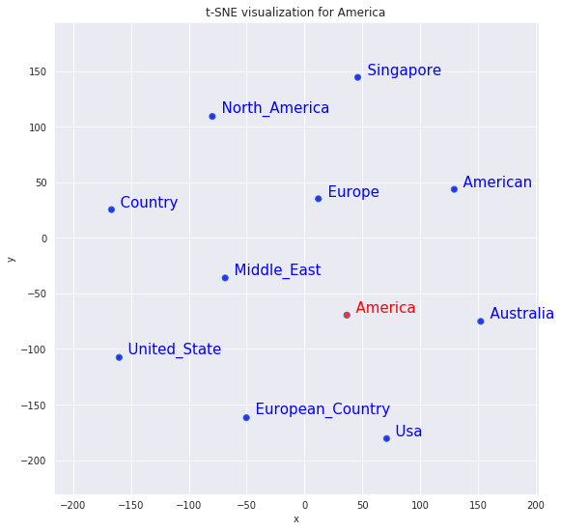
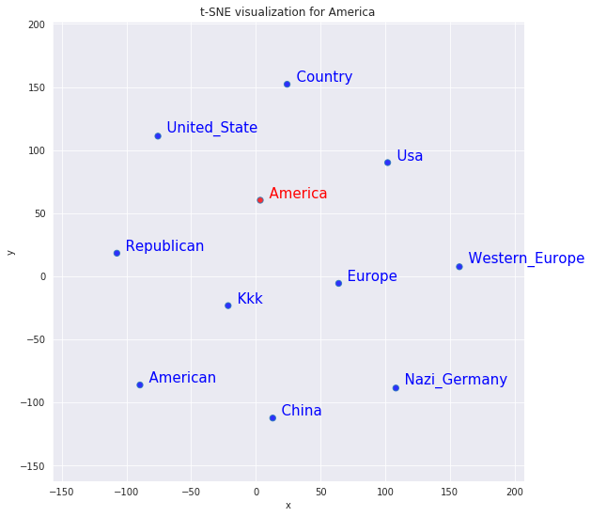
Group 15 James, Daniel
How Singaporean’s felt on certain issues
By looking at the highly related words
2012 - 2016
2019
After Trump has entered the White House, people seem to relate America to racism with entities such as the KKK and Nazi Germany
Notes:
After trump has entered the White House People seem to relate america to racism with words such as KKK and Nazi Germany

Slide 12
Group 15 James, Daniel
Are Reddit Singaporeans Sexist?
Analogical relations between males and females
Clothe - Male + Female = ?

Slide 13
Group 15 James, Daniel
Are Reddit Singaporeans Sexist?
Analogical relations between males and females
Clothe - Male + Female = Change Diaper

Slide 14
Group 15 James, Daniel
Are Reddit Singaporeans Sexist?
Analogical relations between males and females
Strong - Male + Female = Weak
Top - Male + Female = Bottom
Degree - Male + Female = Diploma
Males tend to be closer related to more positive adjectives and verbs

Slide 15
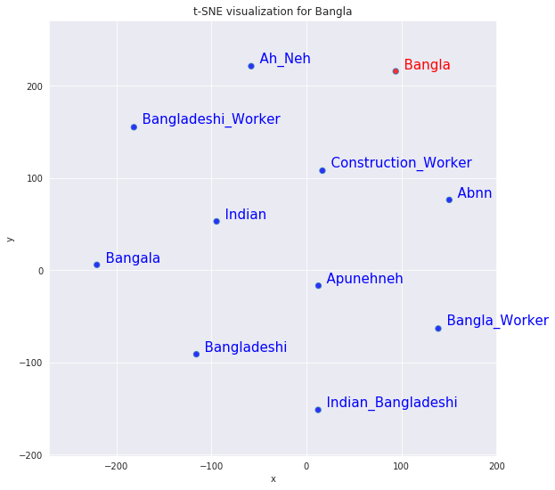
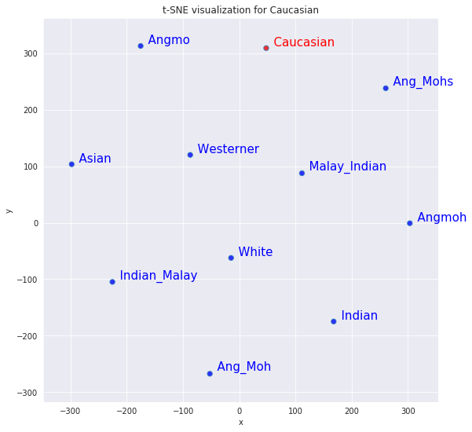
Are Reddit Singaporeans Insensitive to Other Countries?
Looking at highly related words
Bangladesh
Caucasian
Usage of words that may be considered insensitive

Slide 16
Group 15 James, Daniel
Conclusion
How Singaporeans’ use certain words can rapidly change over a short span of a few years
Even new words have been added into our vocabulary
Singaporeans’ opinions on other countries and political issues can quickly shift
We may hold inherent biases and prejudice that we may not even be aware of ourselves, only for it to be uncovered by Word Embeddings
Thus word embeddings can be used for a progressive good to create a better world and reveal hidden biases

Slide 17
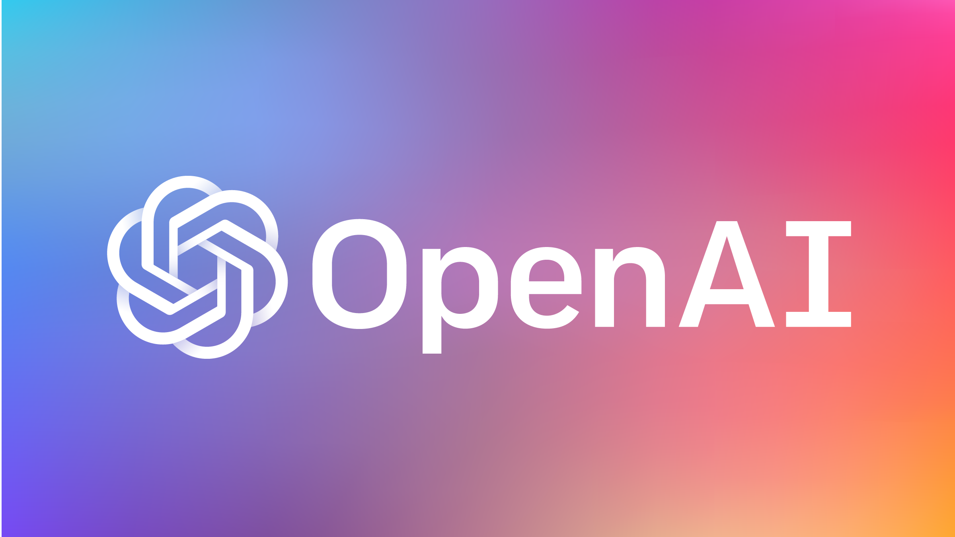
Group 15 James, Daniel
GPT - 2 background
2019 - OpenAI developed GPT-2
Trained by predicting next word in text
Allows the generative of highly realistic text

Slide 18
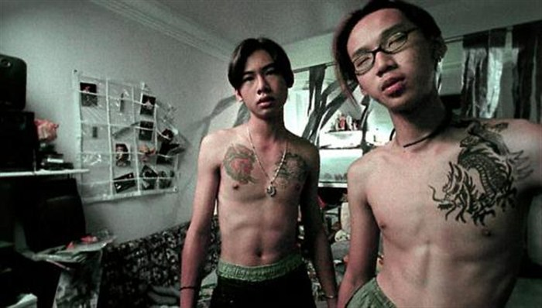
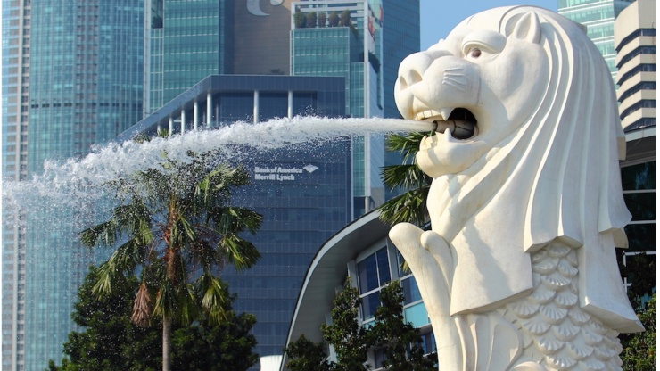
Group 15 James, Daniel
Singlish text
Can gpt-2 generate singlish text?
Or at the least Singaporean related text?

Slide 19
Group 15 James, Daniel
GPT - 2 background
Finetuned medium size (355 million parameters) GPT-2 using r/singapore data
Goal: Generate text in a Singaporean context
All text that you will see, except for the prompt was generated by the model.

Slide 20

Group 15 James, Daniel
GPT - 2 background
Turns out the internet is pretty vulgar
So this model is going to be too

Slide 21
Group 15 James, Daniel
SINGAPORE
SINGAPORE - One man was killed in Yishun when a Daimler Chances canister exploded in his car, killing 29 passengers in the highly anticipated start of a year-long trial which could have halted efforts towards digital innovation and birth rates in the region. Daimler, which broke heavy-hitting, deep-considered regulation in the case, is now causing headaches in other industries where the 2,400 members of their workplace are busy redrawing a code of conduct, from energy to finance and large government data to hack databases.
Long term dependency. Daimler - in fact the text output was much longer than this. But still coherent with daimler and car.
Model correlates Yishun with Singapore

Slide 22
Group 15 James, Daniel
Ccb knn
ccb knn to play liao. But oh well. I won't join an SG group.
ccb knnfk. Didnt see anything wrong with that. I prefer more mala.
ccb knn im in a high ses family ah
ccb knn sian. I mean if you're dead and resting...
Very singaporean way of writing

Slide 23
Group 15 James, Daniel
PAP
Prompt: PAP (the ruling party) Generated: PAP’s dominance in the region is now so strong that Singaporeans are likely to vote for them. That, coupled with the fact that many of the Singaporeans who voted for Trump are white nationalist, cloaked in explained patriotism, makes me wonder if the country would become as politically impotent as it has been for the past 50 years. Singaporeans are generally apolitical and conservative. They have little interest in politics and politics are their only hobby.
Failure case. GPT-2 trained on internet text, alot of americans.
Last Sentence doesn’t make sense

Slide 24
Group 15 James, Daniel
PAP
PAP MP for GRC Teo Chee Hean's Teck Whye constituency apologised to the families of all the families who had lost their loved ones, as well as to the families of the victims. He added that Mr Teck's conduct has been "a matter of public fascination and reflection" since his election in May 2014. The incident, which happened on December 2 last year, prompted Mr Teck to apologise on behalf of Char Boon Khi Wong, who lost her husband, Jeyaratnam Syajee, a businessman, in a Park Geil Air flight in 2013.
Dense model remember alot of weights
PAP - political unit
GRC

Slide 25
Group 15 James, Daniel
BT4222
The prompt:
In NUS, a group of students took the module BT4222, Mining Web Data for Business Insights, under Assistant Professor Qiao Dandan

Slide 26
Group 15 James, Daniel
BT4222
In NUS, a group of students took the module BT4222, Mining Web Data for Business Insights, under Assistant Professor Qiao Dandan. He worked closely with Dr Wang Anh at the University of Southampton, which she founded in 2009 in the UK. It has since been recognised as one of the best global CS courses in the world. It has also been recognised by the Foreign Computer Scientists Association, like the course it is now, with the Fellowship award. ; So far, less than a month and a half after its launch, the course has attracted over 600 students and 70 foreign researchers. ; The degree is focused on Web and mobile apps, including the ability to analyze data.
Most of the generative samples assume gender = male

Slide 27
Group 15 James, Daniel
BT4222
The prompt:
In NUS, a group of students took the module BT4222, Mining Web Data for Business Insights, under Assistant Professor Qiao Dandan
The students had to create a project using Natural Language Processing tools. One of her students, James, did not know what to do for his project and so

Slide 28

Group 15 James, Daniel
BT4222
In NUS, a group of students took the module BT4222, Mining Web Data for Business Insights, under Assistant Professor Qiao Dandan. The students had to create a project using Natural Language Processing tools. One of her students, James, did not know what to do for his project and so he spent hours creating memes to throw at the other students. A similar phenomenon happened in the other school of the same level. It appears that the students were unable to create a task as simple as pick a random phrase from a common dictionary,
Generates language and web related content.

Slide 29
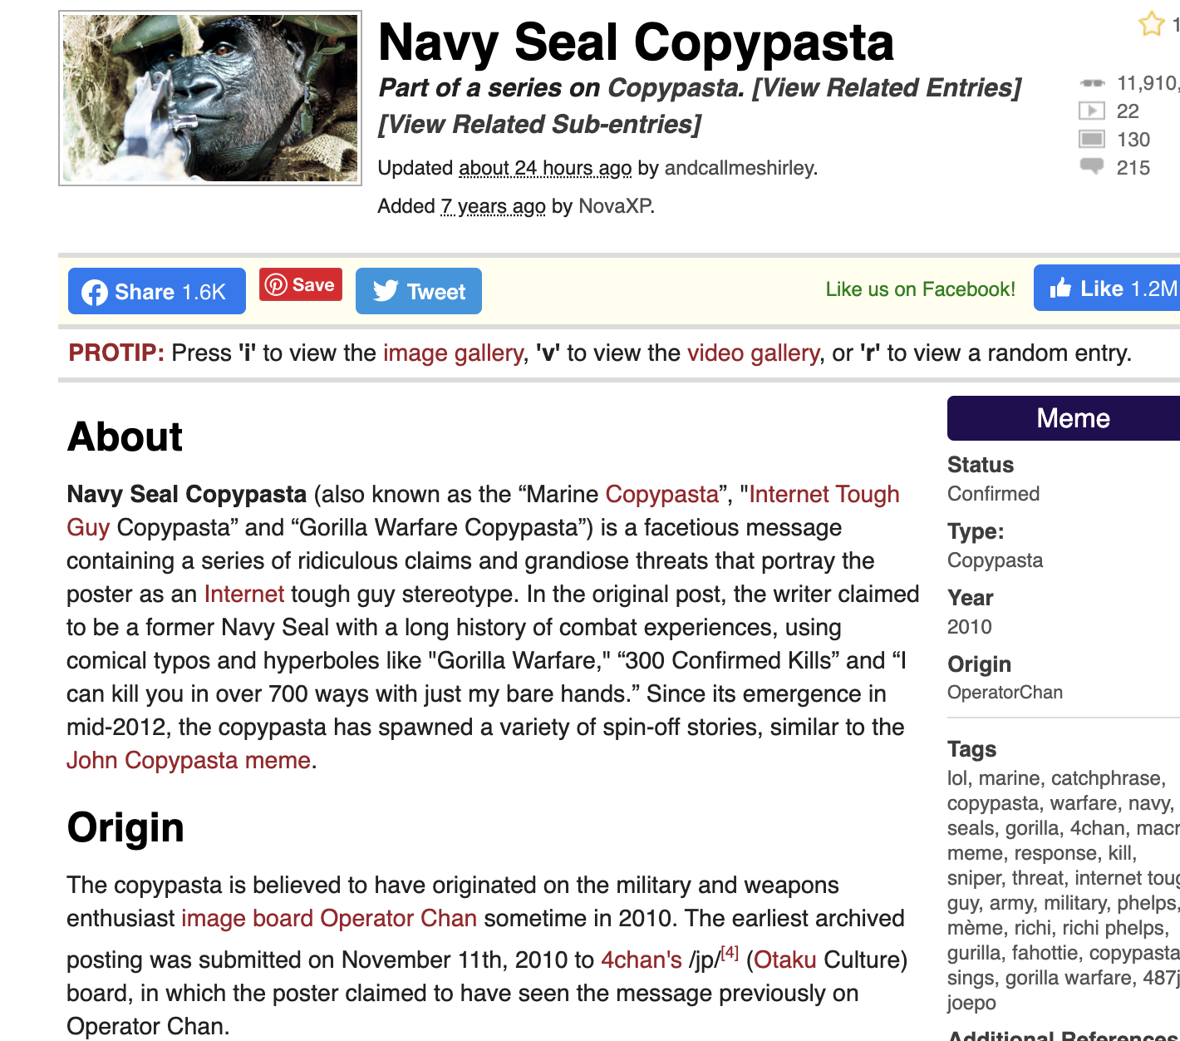
Group 15 James, Daniel
Copypasta
What the fuck did you just fucking say about me, you little bitch? I'll have you know I graduated top of my class in the Navy Seals, and I've been involved in numerous secret raids on Al-Quaeda, and I have over 300 confirmed kills. I am trained in gorilla warfare and I'm the top sniper in the entire US armed forces. You are nothing to me but just another target. …………………………………………………...

Slide 30
Group 15 James, Daniel
Copypasta
The Prompt:
“What the fuck did you just fucking say about me, you little bitch? I'll have you know I graduated top of my class in the SAF”
Can the language model understand SAF - the Singapore Armed forces?
Can it complete the phrase with Singaporean army related information?

Slide 31
Group 15 James, Daniel
Copypasta
What the fuck did you just fucking say about me, you little bitch? I'll have you know I graduated top of my class in the SAF, with a double degree from NUS and NTU. I have connections in the intelligence community, including being the top marksman in my entire unit and I can practically shoot you down with my fucking simple rifle.

Slide 32

Group 15 James, Daniel
Conclusion
Current state of the art models can create and understand text really well
OpenAI initially afraid that it’s model would be abused for fake news
We can create text resembling a local “dialect” by finetuning GPT-2 on samples of it.
Can finetune model on different tasks e.g. sentiment analysis

Slide 33
GROUP 15
JAMES
DANIEL

